Slide 1

ALY 6140 Final Project
Web Scraping
By - Archit Barua
Bhagyashri Kadam
Nikshita Ranganathan

Slide 2
Table of contents
01
Introduction
02
Beautiful Soup Overview & Applications
03
Selenium Overview & Application
04
Scrapy Overview

Slide 3
— Mitchell Kapor
“Getting information off the internet is like taking a drink from a fire hydrant.”

Slide 4
Introduction
01

Slide 5
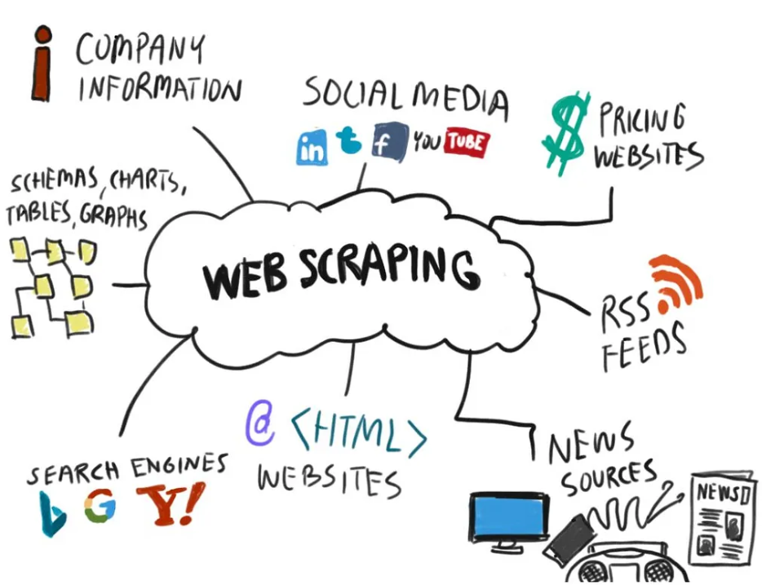
Web Scraping
Targeted Extraction: Pulling specific information from websites automatically.
Automation Advantage: Faster and more accurate than manual data collection.
Data Transformation: Turning non-tabular or unstructured web data into structured formats.
Versatile Applications: Useful for competitive analysis, market research, and more.
Notes:
1. Targeted Extraction
"Web scraping lets us pinpoint and collect specific information from websites. Think of it like using a magnifying glass to find exactly what we need on a vast web page, whether it's product prices, headlines, or contact details, without getting lost in unnecessary details."
2. Automation Advantage
"Doing this task manually is slow and prone to mistakes. With web scraping, we automate the process, making it faster and more accurate. Computers do the heavy lifting, collecting data 24/7 without getting tired or making human errors."
3. Data Transformation
"Web data often comes in a jumble. Web scraping organizes this mess into a tidy format we can actually use, like a spreadsheet or database. This makes it easy to analyze, share, and make decisions based on the data."
4. Versatile Applications
"Web scraping isn't just about grabbing data; it's what you do with it that counts. Businesses use it to keep an eye on competition, marketers to find new leads, and researchers to gather valuable information. It's a tool with endless uses, limited only by our needs and creativity."

Slide 6
Beautiful Soup Overview & Applications
02

Slide 7

Beautiful Soup
Parser: Beautiful Soup breaks down HTML/XML for easy navigation.
Selector: It targets specific webpage elements efficiently.
Pythonic: Integrates with Python for scripting convenience.
Efficient: Streamlines data extraction from web content.
Notes:
Parser
"Beautiful Soup acts like a translator for HTML and XML, turning complex web pages into a format that's easy for us to understand and work with in Python."
Selector
"With Beautiful Soup, we can pinpoint exactly what data we want from a page. Think of it as using a search tool to quickly find the specific information we need."
Pythonic
"It's built for Python, which means it works naturally with Python's syntax and structures, making our code cleaner and easier to write."
Efficient
"Beautiful Soup speeds up the web scraping process. It simplifies tasks that would otherwise be complicated, saving us time and effort."

Slide 8
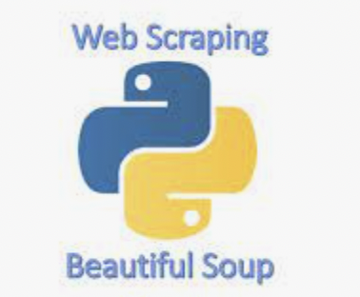


Toolkit for Billionaire List (Wikipedia) Web Scraping
Beautiful Soup: For parsing HTML and XML documents.
Requests: To make HTTP requests to Wikipedia.
Pandas: For creating and manipulating data structures.
CSV Module: To save structured data into a CSV file.
Notes:
Beautiful Soup
"Beautiful Soup is a Python library that helps us sort through the complex HTML on Wikipedia. It's like a filter that helps us find the names and fortunes of billionaires among all the other text."
Requests
"Requests is a way for our script to ask Wikipedia for the page we want to scrape. It’s like knocking on a door and having the page delivered to us."
Pandas
"Pandas takes the raw data we scrape and puts it into tables that are easy to read and analyze. It's like taking a pile of papers and organizing them into neat stacks."
CSV Module
"The CSV module is our way of saving the data we collect into a file that can be opened in programs like Excel. It's like saving a document in a format that everyone can read."

Slide 9
Process :
Retrieve Content: Use requests to get the Wikipedia page HTML.
Parse Webpage: Employ Beautiful Soup to navigate the HTML structure.
Extract Data: Identify and pull table data of billionaires.
Save Data: Organize data with Pandas and write to CSV file.
Notes:
Retrieve Content
"We start by using Requests to grab the HTML from the Wikipedia page. It's just like using a browser to go to a web page, but we do it with code."
Parse Webpage
"Next, we use Beautiful Soup to make sense of the HTML we got. This is like taking a messy room full of furniture and giving everything a proper place."
Extract Data
"Once we've got everything organized, we pick out the parts we want – the table with the billionaires’ information. It’s like spotting the items on a shopping list."
Save Data
"Finally, we put all this information into a format we can use later, with Pandas helping us to arrange it neatly. Then we save it as a CSV file, which is like packing up our findings into a box labeled for easy identification."

Slide 10
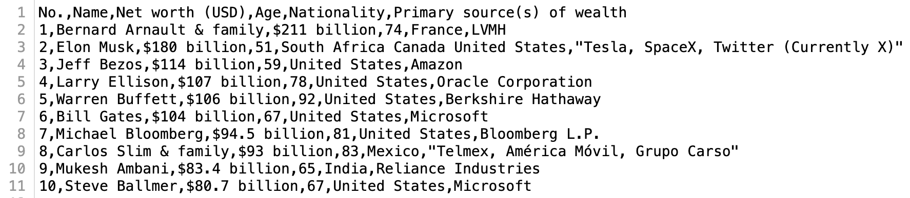
Scraped Data

Slide 11
Selenium Overview & Application
03

Slide 12
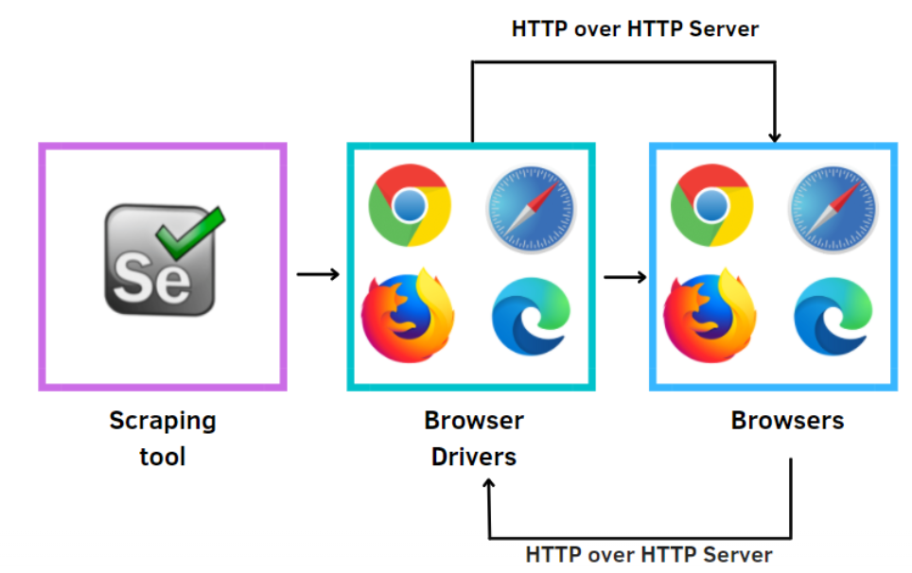
Selenium
How it works?
Use cases - E-commerce (Price comparisons),
Sentiment analysis & job posting.
Challenges

Slide 13
Toolkit for Amazon Web Scraping
Beautifulsoup4
Selenium
Pandas
chromedriver_autoinstaller

Slide 14
Process :
Navigating to Amazon with Selenium Webdriver
Parsing HTML with BeautifulSoup
Extracting Product Details
Structuring the extracted data & Saving it.

Slide 15
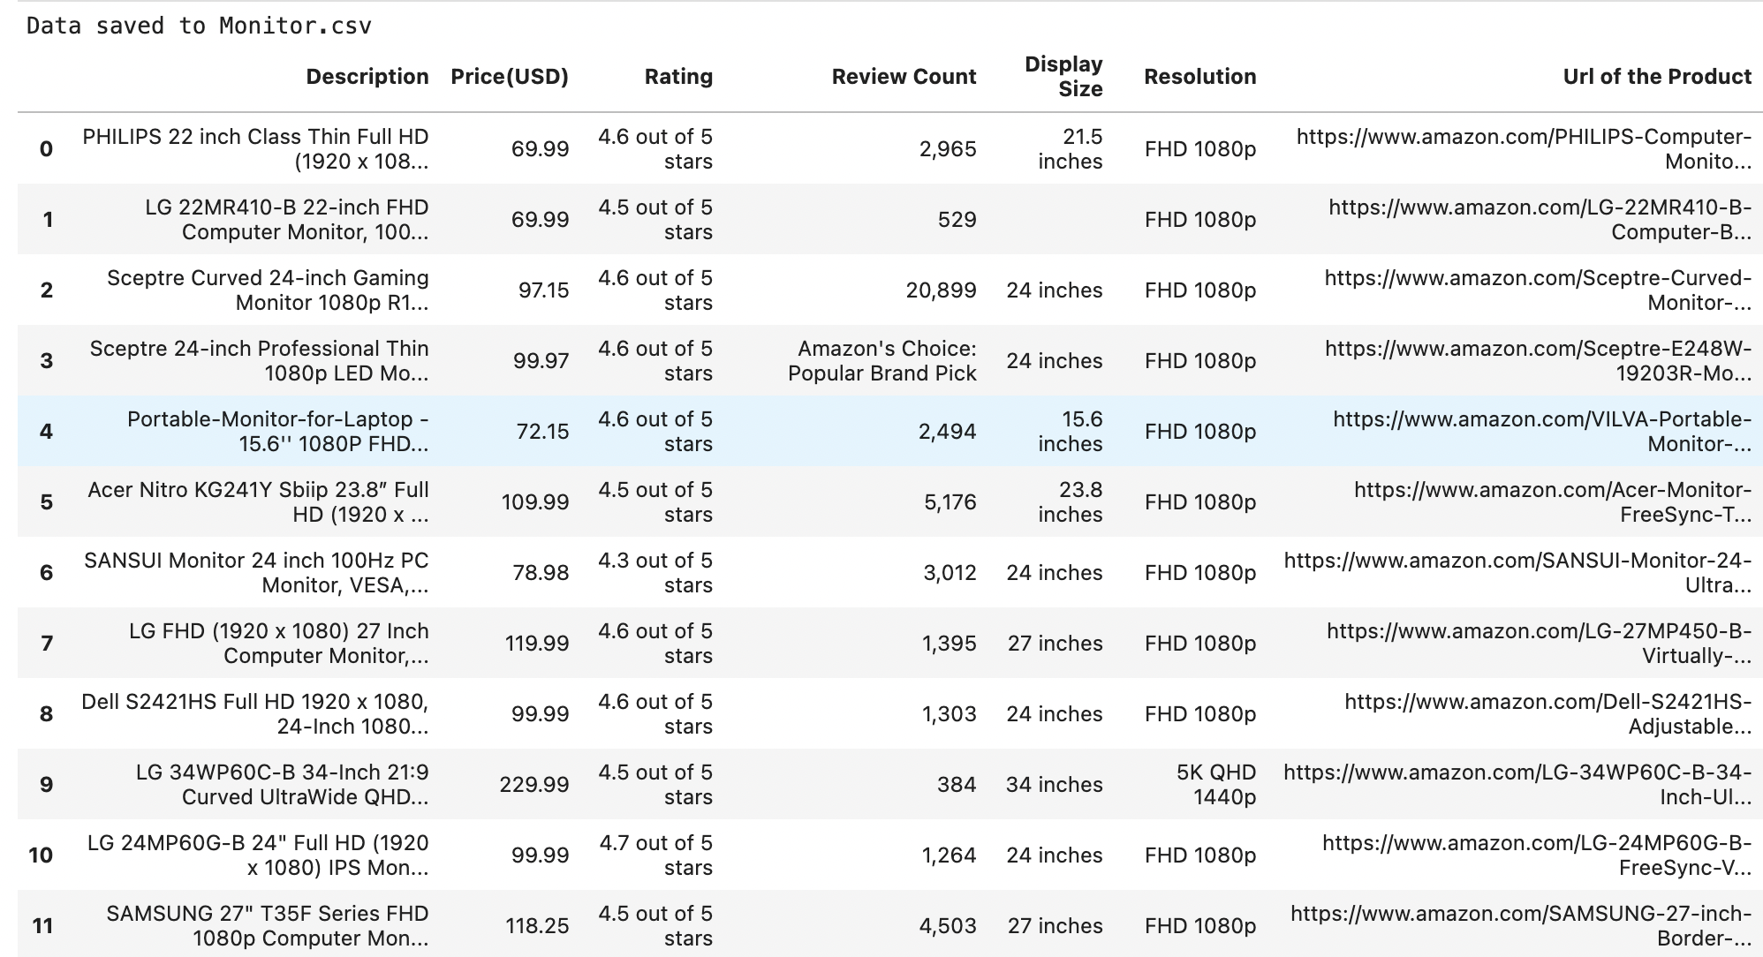
Scraped Data from Amazon

Slide 16
Scrapy Overview
04

Slide 17

Scrapy
Open-source framework: Developed in Python, primarily used for web crawling and extracting structured data
Built with a focus on performance, it can manage large crawls and complex data extraction.
Can scrape data from APIs, single pages, or perform large-scale crawls of entire domains.
Efficiently Handles requests asynchronously, making it faster than tools that make synchronous requests.
Designed to scale up and automate large crawls across multiple servers.

Slide 18
Thanks!
Do you have any questions?

